Slide 1
CHAPTER 1
FUNCTIONS AND MODELS

Slide 2
CONTENTS
1.1 Four ways to represent a function
1.2 Model and Curve Fitting
1.3 New Functions from Old Functions
1.4 Graphing Calculators and Computers
1.5 Exponential Functions
1.6 Inverse Functions and Logarithms
1.7 Parametric Curves

Slide 3
1.1 FOUR WAYS TO REPRESENT A FUNCTION
1.1.1 Examples of Functions
1.1.2 Representations of functions
1.1.3 Piecewise defined functions
1.1.4. Symmetry
1.1.5. Increasing & decreasing functions

Slide 4
1.1.1 Examples of functions
The human population depends on the time
Year | Population (million)
1910 | 1750
1920 | 1860
1930 | 2070
1940 | 2300
1950 | 2560
1960 | 3040

Slide 5
1.1.1 Examples of functions:
The area A of a circle depends on its radius r: A=π r²
The cost C of mailing a first-class letter depends on the weight w of the letter
The vertical acceleration of the ground during an earthquake is a function of the elapse time t
Those are examples of functions

Slide 6
A function f is a rule that assigns to each element x in a set A exactly one element y=f(x) in a set B
x
y=f(x)
a
b=f(a)
f
A
B
A is the domain, B is the range of f.
x is the independent variable, y is the dependent variable

Slide 7
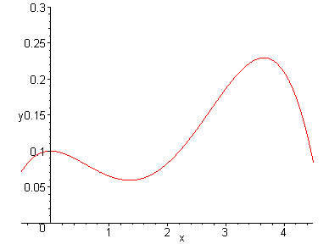
The graph of f is the set {(x,f(x)) / x ∈ A}
(x,f(x))
(2,f(2))
(1,f(1))
x

Slide 8
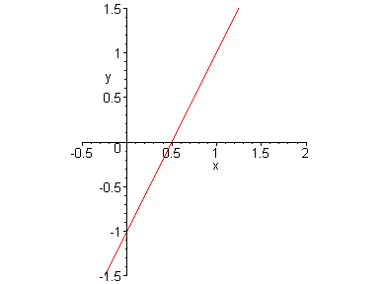
Example: sketch the graph and find the domain & range of f(x)=2x-1
y=2x-1
The graph is the set of all points (x,y) where y=2x-1
This is a straight line with slope 2, y-intercept –1 and x-intercept 0.5
domain(f) = range(f) = R, the set of real numbers

Slide 9
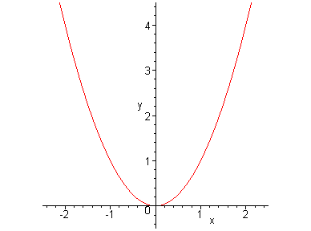
Example: sketch the graph and find the domain & range of f(x)=x²
(2,4)
(-1,1)
(1,1)
the parabola passing through (0,0), (-1,1), (1,1), (2, 4)
domain(f) = R, range(f) = [0, ∞)

Slide 10
1.1.2 Representations of functions
Four ways to represent a function:
Verbally
Numerically (by a table of values)
Visually (by a graph)
Algebraically (by an explicit formula)
Choosing which method depending on the problem

Slide 11
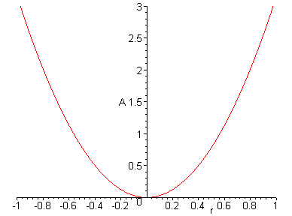
The natural way to represent the area of a circle as a function of the radius is an algebraic formula A=π r².
The graph of this function is a parabola

Slide 12
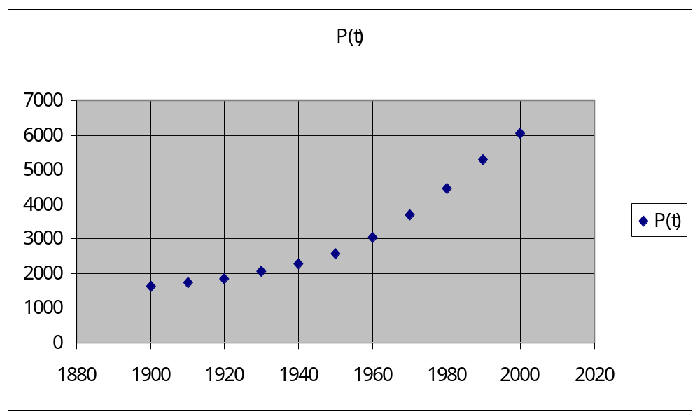
For the function P(t) expressing the dependence of human population in time, one can express it verbally, then construct a table of values.
The graph of this function is a scatter plot

Slide 13
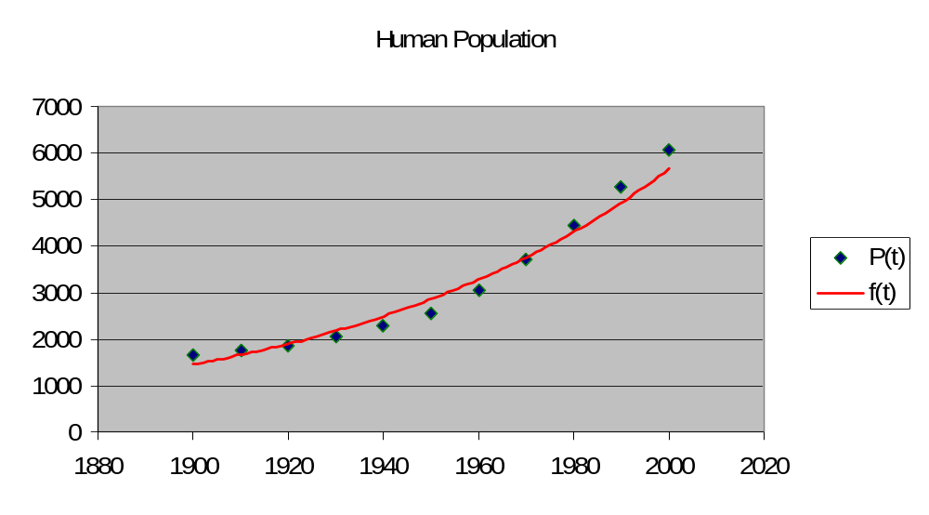
We can also find an algebraic formula f(t) that gives an approximation of P(t)
P(t) ≈ f(t)=0.008196783*(1.013723)^{t}

Slide 14
The natural way to represent the function C(w) expressing the cost of mailing first class letter is using a table of values
w (ounces) | C(w) (dollars)
0<w≤1 | 0.34
1 <w≤2 | 0.56
2 <w≤3 | 0.78
3 <w≤4 | 1.00
4 <w≤5 | 1.22
…

Slide 15
Example. when turning on a hot-water faucet, the temperature T of the water depends on how long the water has been running
The above graph expressing T as a function of time

Slide 16
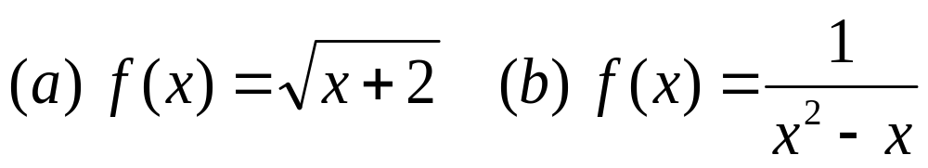
Example. find the domain of each function
For the square root to be well defined, we must have x+2 ≥ 0. Therefore
domain(f)=[-2, ∞)
(b) The denominator of f(x) vanishes when x=0 or x=1. Therefore
domain (f) = {x/x ≠ 0 and x ≠ 1}
= (- ∞, 0) ∪ (0, 1) ∪ (1 , ∞)

Slide 17
The Vertical Line Test: a curve in the xy-plane is the graph of a function of x iff no vertical line intersects the curve more than once
x=a
x=a
(a,c)
(a,b)
(a,b)
a
a
This is the graph of a function of x
This is not the graph of a function of x

Slide 18
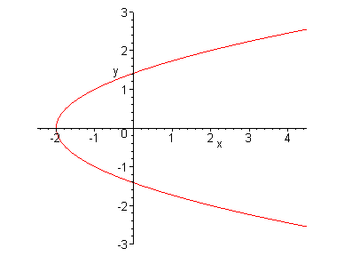
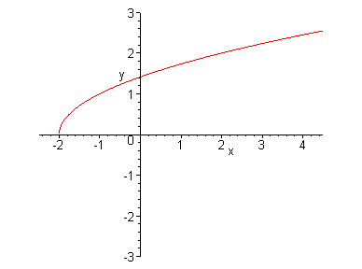
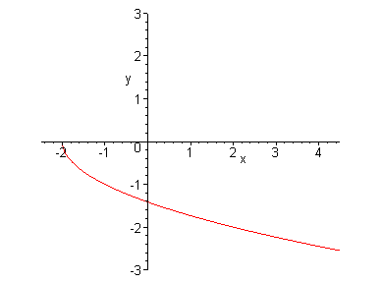
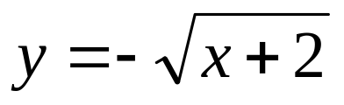
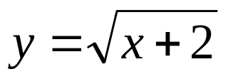
According to the Vertical Line Test, the parabola x=y² – 2 is not the graph of a function of x
However its halves are graphs of functions of x

Slide 19
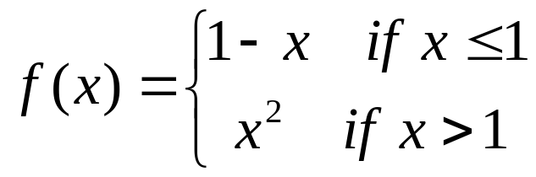
1.1.3 Piecewise defined functions
f(0)=1 – 0 = 1,
f(1) = 1 – 1 = 0
and f(2)=2²=4
1
1
The graph consists of half a line with slope –1 and y-intercept 1;
and part of the parabola y = x² starting at the points (1,1) (excluded)

Slide 20
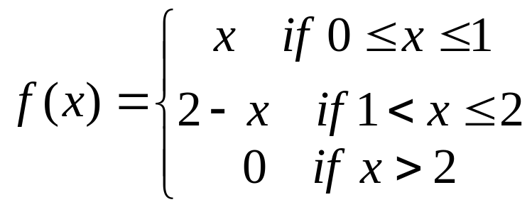
Example: find a formula for the function corresponding to the following graph
The equation of the line joining (0,0) and (1,1) is y=x
The equation of the line joining (1,1) and (2,0) is:
y – 0 = –1 *(x–2) or y = 2–x
(1,1)
1
1
2

Slide 21
1.1.4. Symmetry
A function is an even function if f(–x)=f(x) for every x in the domain of f. Its graph is symmetric with respect to the y-axis.
For example f(x) = x² is even
(-2,4)
(2,4)
(-1,1)
(1,1)

Slide 22
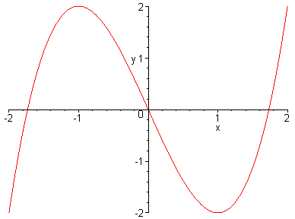
1.1.4. Symmetry
A function is an odd function if f(–x)= –f(x) for every x in the domain of f. Its graph is symmetric with respect to the origin.
For example f(x) = –x³ + 3x is odd
(-1,2)
(2,2)
(1,-2)
(-2,-2)

Slide 23
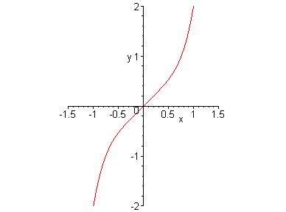
Example: (a) is f(x)=x⁵+x even, odd or neither even nor odd ?
We have: f(–x)= (–x)⁵+ (–x)= –x⁵ –x = –f(x), for all x. Therefore f is odd. The graph of f is symmetric with respect to the origin

Slide 24
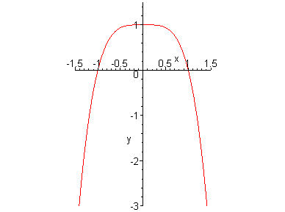
Example: (b) is g(x)=1 – x⁴ even, odd or neither even nor odd ?
We have: g (–x)= 1 –(–x)⁴=1 – x⁴ = g(x), for all x Therefore g even. The graph of g is symmetric with respect to the y-axis

Slide 25
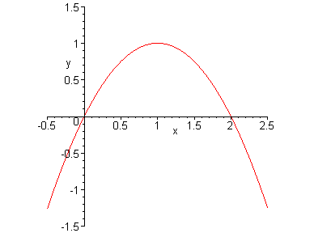
Example:(c) is h(x)=2x – x² even, odd or neither even nor odd ?
We have:h(–x)=2 (–x) – (–x)²= –2x – x². It seems that h is neither even nor odd. Moreover the graph of h is unsymmetric with respect to the y-axis or the origin

Slide 26
Summary
A function is an even function if f(x)=f(–x) for every x in the domain of f.
A function is not an even function if we can find a special value x = a such that: f(a) ≠ f(–a)
A function is an odd function if f(x) = –f(–x) for every x in the domain of f.
A function is not an odd function if we can find a special value x = a such that: f(a) ≠ –f(–a)

Slide 27
In the case of h(x) = 2x –x², we will try to find special values for the independent variable to show that it is neither even nor odd
We have:
h(–1) = 2(–1) – (–1)² = –3
while
h(1) = 2 – (1)² = 1
Since h(–1) ≠ h(1), h is not even
Since h(–1) ≠ –h(1), h is not odd.

Slide 28
1.1.5. Increasing & Decreasing Functions
A function f is an increasing function on an interval I if
f(x₁) < f(x₂) whenever (if) x₁ < x₂ in I
f is decreasing on I if
f(x₁) > f(x₂) whenever (if) x₁ < x₂ in I
The graph of an increasing function is rising and that of a decreasing function is falling.

Slide 29
D
y=f(x)
B
C
A
a
b
c
d
The function f is increasing in the intervals [a, b] and [c, d]
f is decreasing in [b, c]

Slide 30
Example:
The function f(x) = x² is decreasing on the interval (-∞, 0]
and f is increasing on [0, ∞)

Slide 31
Remark:
To verify that a function f(x) is non-increasing on the interval I, we need to find two values x₁ and x₂ in I such that x₁ < x₂ but f(x₁) ≥ f(x₂)
To verify that a function f(x) is non-decreasing on the interval I, we need to find two values x₁ and x₂ in I such that x₁ < x₂ but f(x₁) ≤ f(x₂)

